Slide 1
Economic Development of Arkansas
Overview of the impact of economic development to regions of the state during different time periods.

Slide 2
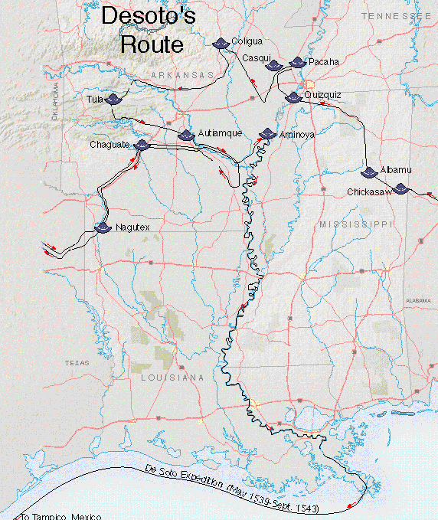
European Exploration
Notes:
Early explorers were in search of gold and silver. The earliest European Explore in what became Arkansas was Hernando de Soto from Spain searching for gold and silver and converts to Christianity. 150 years later French Explorers followed laying claim for France and looking to expand trade.

Slide 3
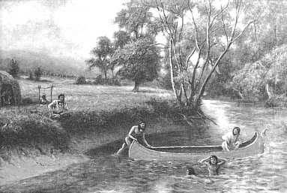
Hunting and Farming by Native Americans
In 1541 rather than gold Hernando de Soto found Native Americans.
Indians survived by gathering berries, hunting and farming corn, squash, and beans.
Systems of rivers and trails connected the towns to each other enabling trade.
Notes:
Native American lived throughout the area that became Arkansas when the first Europeans arrived searching for gold. The Native American lived in villages and survived on hunting and farming.

Slide 4
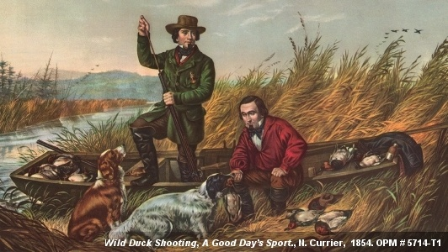
French Trading of Furs
Arkansas Post was first European establishment in Arkansas primarily for fur trading.
The French explorer Henri de Tonti, established Arkansas Post at juncture of the Arkansas and Mississippi rivers.
French goods (knives, hammers) were exchanged for beaver furs.
Rivers were used for transportation of traded items.
Notes:
The first European settlement was made by the French at Arkansas Post primarily for trading for beaver furs with the Native Americans. Transportation was almost entirely by rivers.

Slide 5
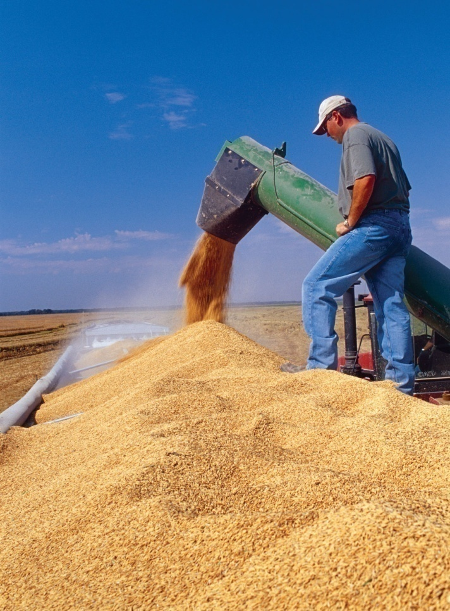
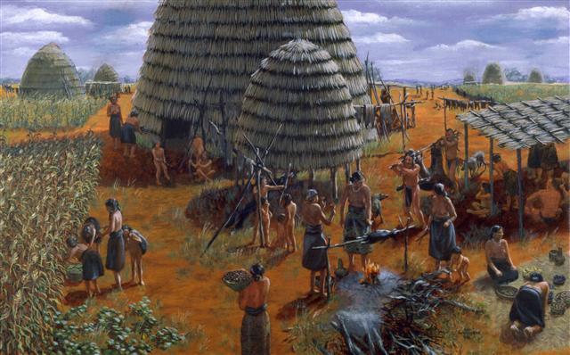
Agriculture
Notes:
Early development used the vast natural resources of Arkansas including fertile alluvial plains and water resources primarily for agriculture. Major Agri-business over history have been cotton, rice, soybeans, poultry, and corn.

Slide 6
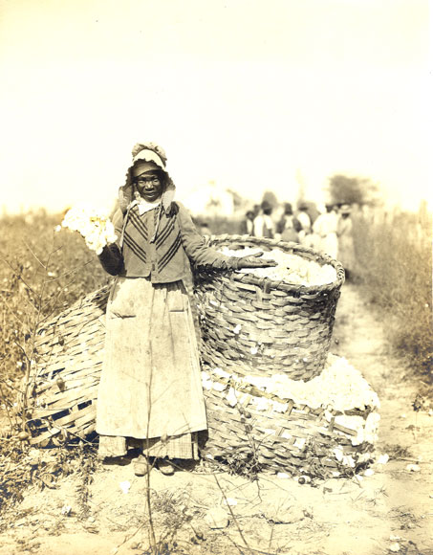
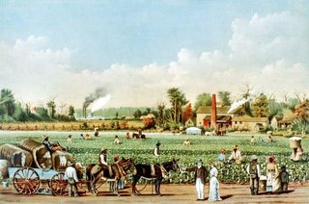
Cotton Plantations
Early 1800s cotton production led the settlement of the territory ---mostly along the Mississippi River.
The river was used to transport goods into and out of the plantations.
Cotton dominated Arkansas agriculture until the mid twentieth century.
Cotton remains a strong cash crop for Arkansas - 2.1 million bales
Notes:
As the area of Arkansas was sold to the United States, in 1803 settlers migrated in from the Old South and brought with them the cotton plantation system with slave labor. Cotton dominated the Arkansas agriculture until well into the 20th century and is still an important crop.

Slide 7
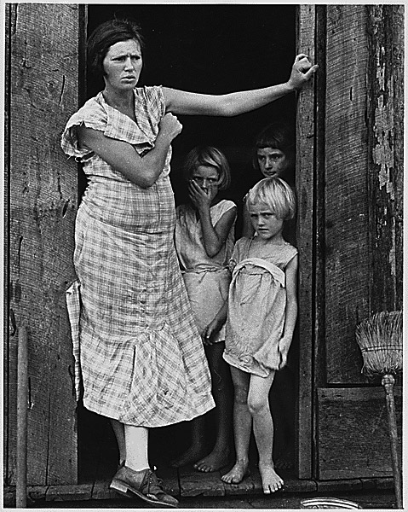
Sharecropping and Tenant Farming
Tenant Farming -most common labor source for cotton production after the Civil War
A typical Arkansas tenant, black or white, rented forty acres from a landowner and farmed with his own mules and family
Landowners – received a fourth of the crop with the remainder going to the tenant
If a sharecropper lacked equipment and capital then his family typically received only fifty percent of the crop
Notes:
As slavery was ended following the Civil War, the need for labor in the cotton fields of the old plantation was met with a system of tenant farming. Landless farmers worked the fields for a portion of their crop and as the price of cotton fluctuated so did their income. The system with its widespread poverty has all but disappeared today.

Slide 8
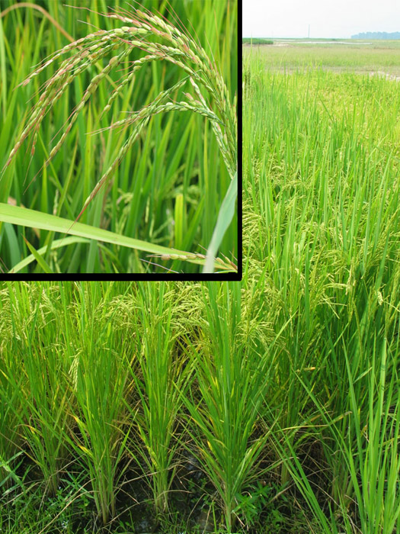
Farming of Rice
Rice became major crop at the start of the 20th century
Today rice is grown in forty Arkansas counties -1.6 million acres in 2005
Arkansas the top rice producing state in the country
In 2005 total rice production was 97.2 million hundredweight of rice.
Most of the rice in Arkansas is marketed through Riceland Foods - a producer cooperative selling rice to countries around the world.
Notes:
Rice production in Arkansas began in the Grand Prairie counties? in Stuttgart in the early 20th century. It spread to other Delta Counties and today Arkansas is the leading rice producing state in the nation.

Slide 9
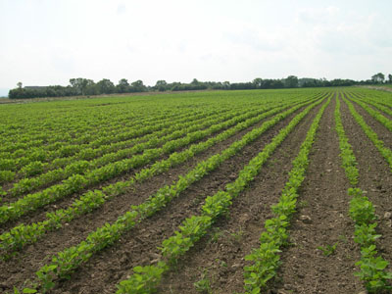
Farming of Soybeans
After WWII rice and soybean production replaced cotton as Arkansas’ major agricultural output
Soybeans became the crop of choice for Delta farmers as they provided a more reliable income stream
Products made from soybeans include body care, polishes, diesel additives, cleaners and more
By 1960 about 6 acres of soybeans were planted for each acre of cotton
Notes:
Soybeans became a major crop in Arkansas in the second half of the 20th century replacing cotton as the largest source of agricultural income.

Slide 10
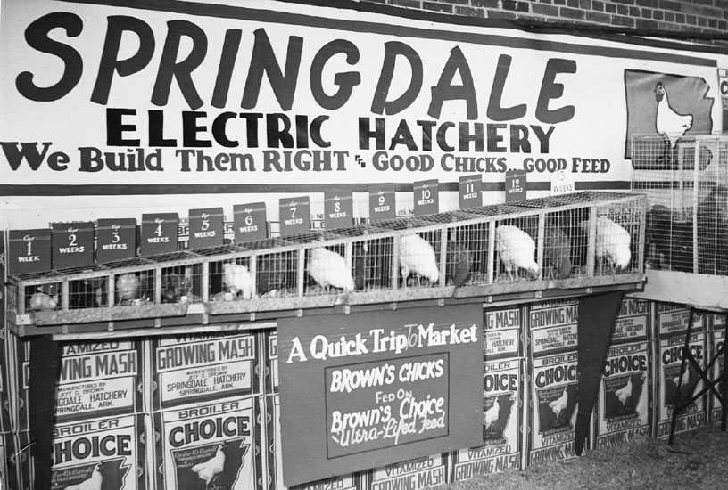
Poultry Industry
Emerged in 1890s as Tyson started transporting chickens to market in Chicago
A century later, Tyson Foods, based in Springdale, is one of the largest agribusiness firms in the United States. With the acquisition of beef and pork production, they became the largest meat producer in the world
The industry includes breeding, chicken growers, feed mills, trucking, processing plants, and marketing.
By the 1970s, Tyson, along with in-state competitors ConAgra and Pilgrim’s Pride propelled Arkansas to becoming the nation’s number-one poultry producer for a period of time
An important development by Tyson was value added to provide consumers with the convenience of ready made meals.
Notes:
Arkansas is one of the two largest poultry producers in the nation. Jobs and income are generated by individual growers, feed mills, trucking, processing plants, etc. Tyson Foods headquarters in Springdale is the largest producer of chicken, pork and beef in the world.

Slide 11
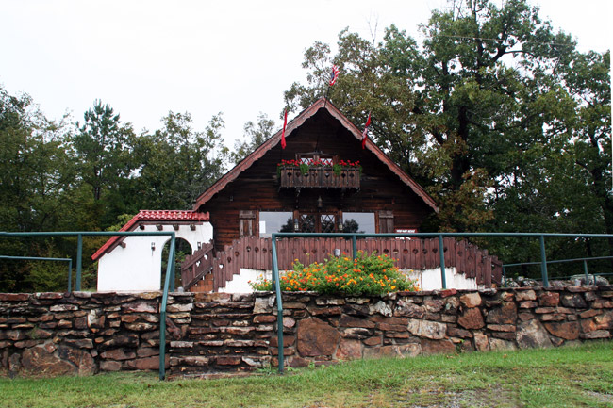
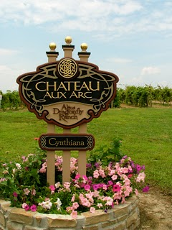
Altus Wine Production
German-Swiss immigrants brought wine production to the state
2 largest wineries - Post Family and Wiederkehr established around 1870
Chateau Aux Arc is newer vineyard and producer
Wine production is small but continues to expand
Notes:
(Amy – how about some logos?)
Arkansas has had a small but viable wine industry for more than 100 years. It was brought to the area around Altus by Swiss-German wine makers at the height of the newly developed railroad.

Slide 12
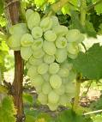
Fruit Production in Arkansas
-Historically Arkansas was home to a wide selection of fruit production. Overtime, regional and global specialization have minimized the scale.
-Festivals celebrating the production commemorate their historical significance.
Examples include:
- Pink Tomato Festival in Warren,
- Peach Festival in Clarksville
- Winefest in Altus
- Grape Festival in Tontitown
- Apple Festival in Lincoln
- Watermelon in Hope
Notes:
Arkansas has a long tradition of fruit production. Washington County was once the leading apple producer in the nation. Festivals are testimony to the important place of Arkansas orchards.

Slide 13
Extractive Industries
After the boom of agriculture, Arkansas’ economic development was based on extractive industries which consumed our existing natural resources
These include timber, oil, bauxite, coal, and natural gas.
Geographically, the industries were located near the source of the raw materials.
Approximate boom dates:
Timber --- 1870s to present
Coal --- 1900 to 1940s
Oil --- 1920s to 1970s with some current production fluctuations
Bauxite --- 1940s to 1960s
Natural gas --- with oil in south and now in Fayetteville Shale Play
Notes:
Arkansas is blessed with abundant natural resources that have resulted in the development of numerous industries.

Slide 14
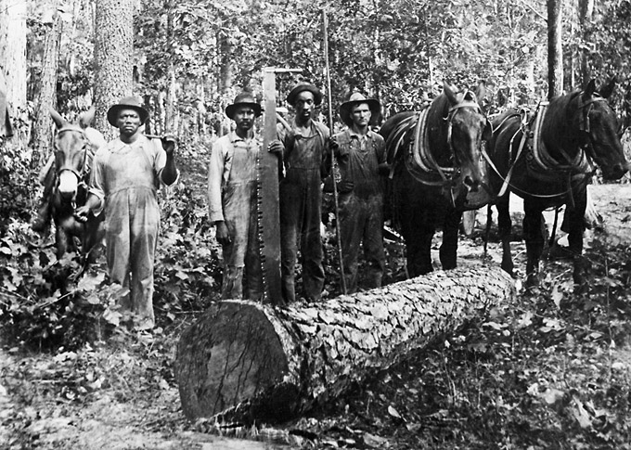
The Timber Industry
Abundant forests enable the production of lumber, craft paper, fine paper, newsprint, chemicals & charcoal
Eastern delta hardwoods grow in the swamps and river bottoms sawed for lumber
Ozark Mountains mix of slower growing pines and hardwoods used for furniture and pallets
The South harvests pine forests for lumber, paper, & particle board. Replacement planting is a common practice due to the rapid growth.
Notes:
The timber industry became a major source of jobs and income in the late 19th and 20th centuries. Most of Arkansas’ hardwood forest have been cut over about three times and the fast growing southern pines many more.

Slide 15
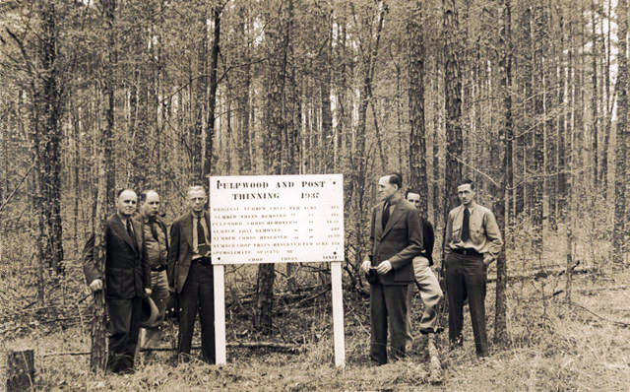
Timber Town Development
Lumber entrepreneurs acquired timberlands in the late 19th century
-hire men
-create feeder RR lines into the forests
-build large sawmills
-harvest virgin forests
Over time additional power equipment , such as tree cutters, road building machinery, haulers, and material management tools, supported larger operations.
Timber towns were established to accommodate workers near the saw and paper mills with all the necessary amenities including a company store, school, church, and doctor.
Everything was owned and controlled by the mill owners. Crossett is an example of a city that began as a mill town. Most no longer exist.
Notes:
Because saw and paper mills require a relatively large capital investment, entrepreneurs came in to set up the mills, build workers houses, provide a company store and often develop a company town with everything owned by the company.

Slide 16
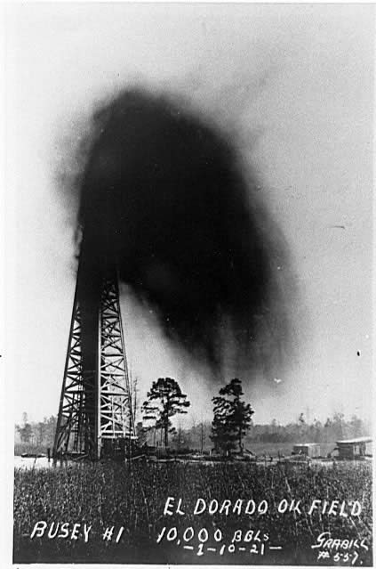
The Arkansas Oil Industry
Oil in Arkansas was originally discovered in 1920 west of Eldorado as the Bussey #1 came in as a geyser.
In 1922 a major discovery was the Smackover Pool near the Union-Ouachita County Line
85% of the oil produced has come from Union, Lafayette, Columbia, and Ouachita counties
From 1920 to present, more than 1.8 billion barrels of oil have been produced in Arkansas
Arkansas’ oil industry is commemorated at the Arkansas Museum of Natural Resources near Smackover
Notes:
Far South Arkansas boomed in the 1920’s with the discovery and development of several oil fields. By the 1940’s production declined but production and refining of oil is still important to the economy of the region.

Slide 17
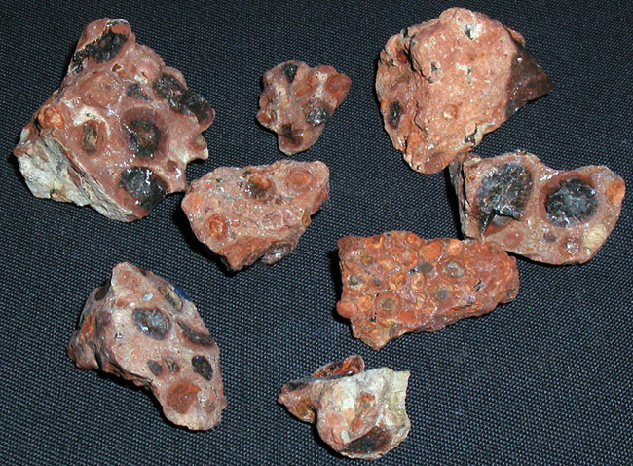
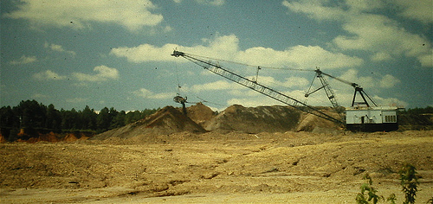
Mining of Bauxite for Aluminum
Bauxite, used to produce aluminum, is the official state rock
Arkansas’ bauxite deposits, near the town of Bauxite (originally a company town) in Saline County, were the largest commercially exploitable deposits in the nation
Arkansas produced more than 90% of all domestic tonnage mined throughout the 20th century
Though the aluminum plants no longer operate, a small amount is currently mined for use in other industries.
Notes:
World War II required a large market for aluminum which is refined from Bauxite. The major domestic deposits of Bauxite was found in Central Arkansas and several large aluminum refining plants provided most of the nation’s aluminum. Today, with the depletion of mines in Arkansas and cheaper foreign sources, very little Bauxite is currently mined in the state.

Slide 18
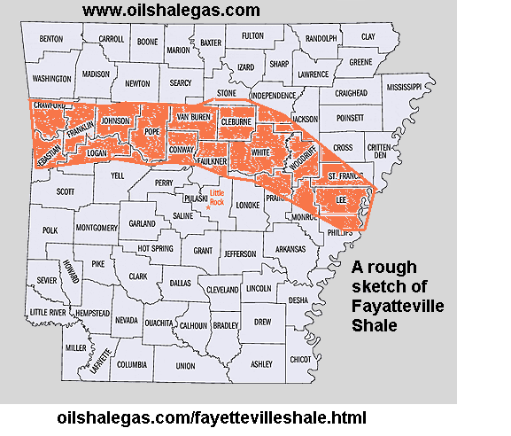
Natural Gas
Natural gas has been produced in conjunction with oil in southern Arkansas since 1920s
Recently, a much larger deposit was discovered in the Fayetteville Shale
The Fayetteville Shale is a black, organic-rich rock of Mississippian age that underlies much of northern Arkansas and adjacent states in the Arkoma basin
The Arkansas River Valley and Conway have experienced growth due to the development of the natural gas industry.
As natural gas prices increase, this resource will have an increased impact on economic development and state revenues.
Notes:
Arkansas has long been a producer of natural gas in the South and Western regions but the newly discovered Fayetteville Shale promises to far exceed previous producers.

Slide 19
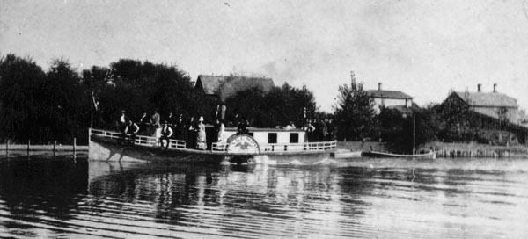
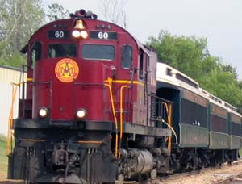
Transportation
A good system of transportation facilitates economic development by moving raw materials and goods to markets, production facilities and to consumers.
Newly available technologies changed transportation modes as we move from river to rail to highways to air transport.
Cities and regions with good transportation systems generally experience greater economic development while others encounter population and economic decline
Notes:
The evolution of transportation has facilitated shifts in economic development in the state. Early settlements were built on rivers and steamboat transportation was important. Railroads followed the Civil War and brought the development of new towns. Next came paved highways with cars and trucks. The interstate highway system combined with the Kerr-McClelland Arkansas River development project facilitated Arkansas’ trade with the world.

Slide 20
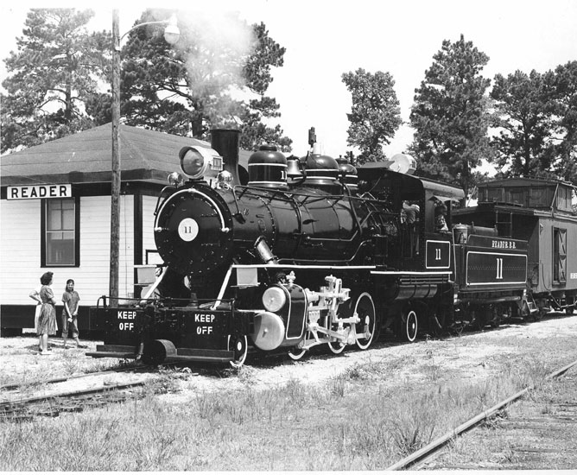
Railroad Development
Construction of railroads created towns where none had existed
Many of these routes were used to transport goods including the cross ties needed to construct the railroads as well as things needed by the workers
Relationship between railroads and timber industry was mutually beneficial
Timber industry needed transportation and the mechanical skills supplied by railroad men
Railroad towns boomed while others withered
Notes:
After the Civil War, railroads were built connecting all parts of the state and replaced rivers as the major transportation system for transporting goods and people. With the development of a system of highways in the mid 20th century, railroads declined but remain important for the movement of freight.

Slide 21
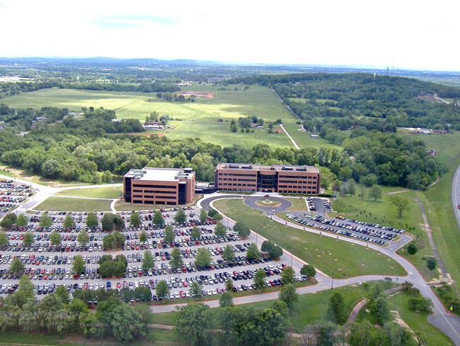
Trucking and Transportation Logistics
Coinciding with the development of Arkansas’ poultry industry was the trucking industry including national companies such as JB Hunt, USA Trucking, Arkansas Best Freight
The rise of Arkansas’ trucking firms coincided with, and reinforced, the developing poultry industry
J.B. Hunt Transport Services, Inc., based in Lowell, AR, is Arkansas’ largest trucking company and one of the largest transportation logistics providers in North America
J.B. Hunt employs 16,000 people
operates more than 11,000 tractors and 47,000 trailers
annual revenues exceeding 2 B
J.B. Hunt
Notes:
Trucking is an important industry centered in Northwest Arkansas. Among a large number of firms, J.B. Hunt headquartered in Lowell is one of the largest transportation firms in the nation.

Slide 22
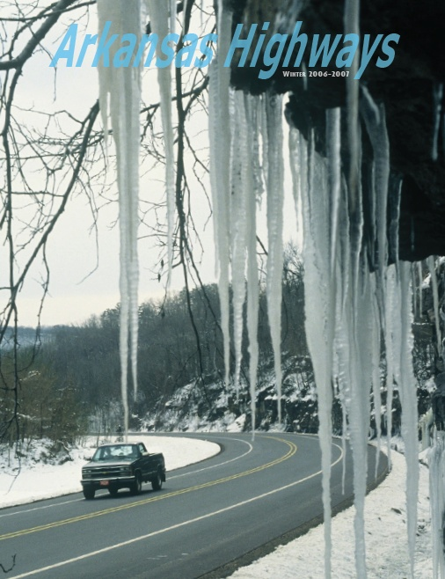
Interstate Highway System
Originally developed in the 1960s, this Federally funded initiative opened up sections of the state to wider markets nationally and ultimately internationally
System of interstate highways facilitated the economic development of towns along the thoroughfares
There are proposals to build more north-south interstate highways in the state
Notes:
The interstate highway system opened up Arkansas industries to markets in the U.S. and the world.

Slide 23
Arkansas River Navigation
Rivers have historically been major determinants of city locations due to the system of transportation they provide especially before the development of rail and paved roads
Transportation on rivers suffered due to water level fluctuations
Technologies of dams and locks facilitated more reliable navigation year around
The major development for Arkansas was the McClellan-Kerr lock and dam system on Arkansas River
Notes:
River transportation has had a revival with the development of the McClellan-Kerr system on the Arkansas River. It is especially efficient for bulk cargo.

Slide 24
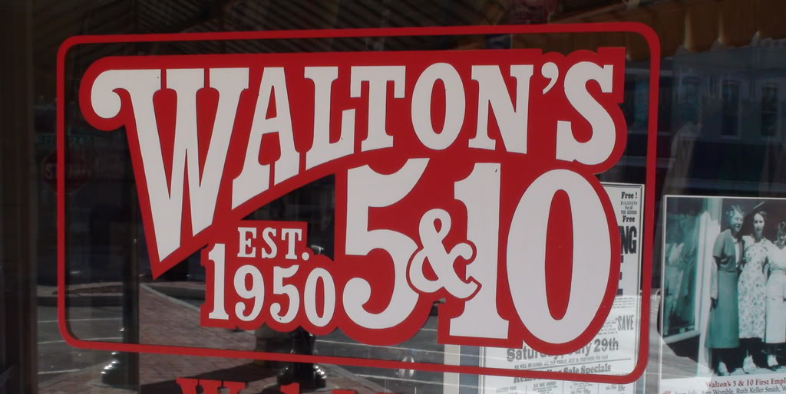
Retail in Arkansas
Retail began with ‘mom and pop’ shops in towns across the state
In the 1960s the emergence of Arkansas based large chain retailer Wal-Mart changed the face of retail by using computer technologies and economies of scale to provide consumer goods at lower prices
Small retailers had to create a niche market to compete with large box stores

Slide 25
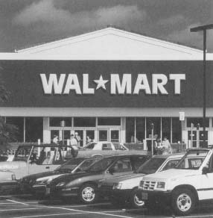
Walmart
Walmart – founded in 1962 by Sam Walton
Walmart is the world’s largest public corporation by revenue - $404 billion annual revenue (add date)
Largest employer in the U.S. – 2 million associates
Stores around the globe in countries such as Argentina, Mexico, China, UK and more
Notes:
Walmart and Dillards, headquartered in Arkansas, have made Arkansas a leader in retailing. Their impact is multiplied by the large number of national and international firms that have a presences in Arkansas to service them.

Slide 26
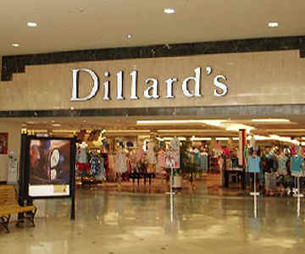
Dillard’s
Dillard’s – founded in 1938 by William T. Dillard
Department store chain selling clothing, household goods, and shoes
330 stores in 29 states
Employees 54,000 people
Annual revenues of $7.59 B
Notes:
William Dillard, with $8000 borrowed from his father, founded the first store in Nashville Arkansas. Today there are 330 stores in 29 states.

Slide 27
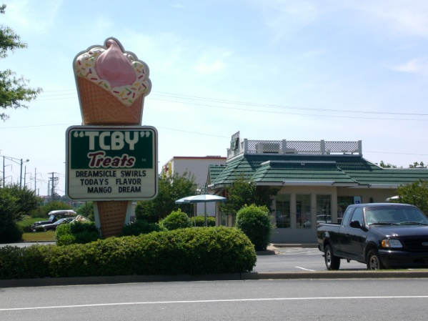
TCBY
TCBY – international frozen yogurt vender which grew over 19 years from a single store in Little Rock to 3,000 outlet franchises. Acquired by Mrs. Fields Famous Brands in 2000.
Notes:
Rita – look up some interesting info

Slide 28
Manufacturing
Whirlpool Corporation is a global manufacturer and marketer of major home appliances - annual sales of $19 B - manufacturing facilities in Fort Smith
Baldor Electric – founded in 1920 – located in Fort Smith – annual revenues of 721 M
-markets, designs, and manufactures industrial electric motors, mechanical power transmission products, drives and generators
Yarnell – ice cream producer based in Searcy, AR
Aromatique – based in Heber Spring, AR
Notes:
Even though Arkansas has traditionally been an agricultural state, manufacturing has become a greater source of jobs and income. Concentration of industries are in the area of Little Rock, Fort Smith, Northwest Arkansas, and Jonesboro but industrial development is evident throughout most of the state.

Slide 29
Technology Industry
Acxiom- global interactive marketing services company – annual revenue 1.38 billion
Alltel- until its acquisition by Verizon in ‘08 was the 5th largest wireless telecommunications company in the U.S. with 8.8 billion in annual revenues – acquired by Verizon
Klipsch - Klipsch, one of the first U.S. loudspeaker companies since 1946 was founded by Paul W. Klipsch - who in the beginning hand-built every speaker inside a tin shed in Hope, Arkansas.
Notes:
One of the most promising avenues for economic development is the technology industry. Which brings high skilled workers and good wages to Arkansas.

Slide 30
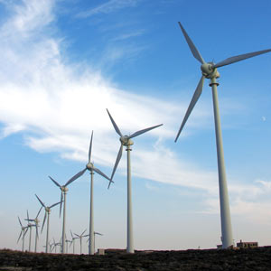
Wind Power Industry
LM Glasfiber is a blade manufacturer in Little Rock- North American headquarters location
Polymarin Composites is a blade manufacturer in LR
One of Polymarin’s main suppliers is Wind, Water Technologies, which has a factory co-located with Polymarin in LR
Nordex building a $100 million factory in Jonesboro. Nordex is a major turbine manufacturer from Germany.
Notes:
Going green promises to be a major source of economic development in the future. Arkansas has a stake in wind power industries but should also forge ahead in other energy-saving, pollution control and sustainability industries.

Slide 31
Arkansas Banking/ Investment Banks
Arkansas is home to a strong banking sector with 143 banks with assets totaling $53 billion headquartered in the state, and 1,488 branches. Notable examples include:
Arvest
Bank of the Ozarks
Pulaski Bank and Trust
Signature Bank
Metropolitan
Notes:
Economic development depends on a strong source of financial capital, small businesses, farmers, start up enterprises all need the services of banks. Arkansas is fortunate to have a strong banking sector.

Slide 32
Tourism in Arkansas
In 2005, an estimated 32.7 million tourists visited Arkansas and spent $4.8 billion.
Arkansas is home to a 52 scenic and recreational state parks
Heifer International is headquartered in Little Rock and now includes the Heifer Village.
The newest notable tourist attraction is the William Jefferson Clinton Presidential Library in Little Rock.
The largest museum of American art, Crystal Bridges, is being built in Bentonville.

Slide 33
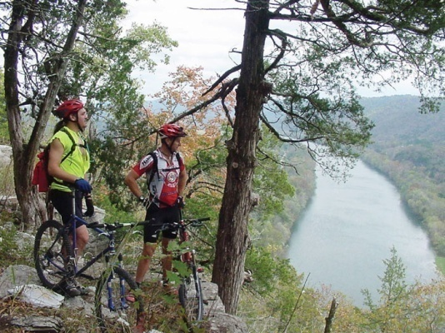
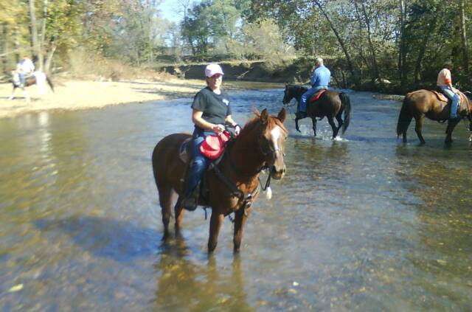
Notable Attractions
Arkansas State Parks – Mt. Magazine, Mt. Petit Jean, Museum of Natural Resources
National Parks – Pea Ridge Battlefield, Hot Springs, Central High, Arkansas Post, Fort Smith National Historical Site
Lakes – Ouachita, Beaver, Greers Ferry, Bull Shoals, Lake DeGray, Lake Chicot
Rivers – Buffalo National River, Cossatot
Hunting – deer, ducks, elk, turkey
Fishing – trout, bass, crappie and catfish
Water sports – skiing, boating
Camping – Devil’s Den, Beaver Lake, Ouachita, Petit Jean
Hiking – Ozark trail, Ouachita trail
Notes:
Arkansas has adopted the slogan as the “natural state”. With that designation it has attracted tourist seeking a natural setting for fishing, camping, hiking, etc.

Slide 34
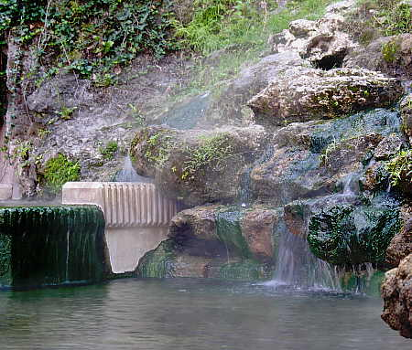
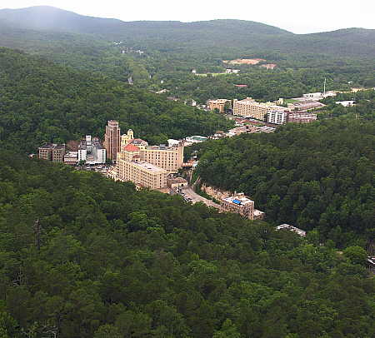
Hot Springs
On April 20, 1832 Andrew Jackson signed an act establishing Hot Springs National Park to preserve the springs
Early 20th century, Hot Springs was one of several spa towns offering medicinal tourism
Today Hot Springs offers:
Horse racing at Oaklawn
Magic Springs theme park
Garvan Botanical Gardens
Notes:
In the early 20th century Hot Springs became nationally known for the perceived healing powers of its thermal springs. It is still an important tourist destination.

Slide 35
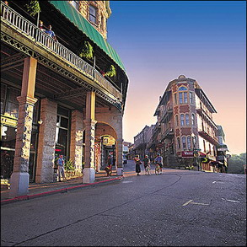
Eureka Springs
According to Indian lore, the hot springs were thought to be healing.
At turn of 20th century the construction of a Frisco railroad line brought people from the north and east to Eureka Springs
It became a popular resort with Victorian styled homes and hotels
Eureka Springs lures tourists by celebrating the traditional culture of the Ozarks
Today it is a resort get away to experience Arkansas art, culture and heritage
Notes:
Eureka Springs developed as another Spa town and was constructed with elaborate Victorian style houses. It is today an important artist colony and tourist destination.

Slide 36
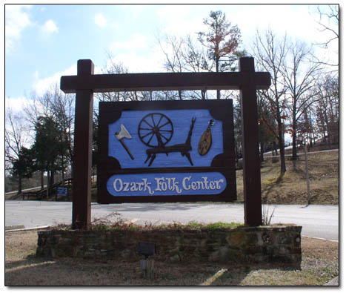
Mountain View
In 1960s, in an effort to preserve the Ozark traditional way of life including crafts and music, under the leadership of Bessie B. Moore, the stated funded the Ozark Folk Center at Mountain View
The folk center has demonstrations of traditional crafts such as pottery, candles, soap, cloth, quilts, violins, dolls, herb gardening, etc.
The calendar includes special musical performances and classes in these traditional crafts.
Notes:
Tucked away in Stone County, the folk center seeks to preserve traditional Ozark crafts and music. Programs range from craft demonstrations to jam sessions on the town square.

Slide 37
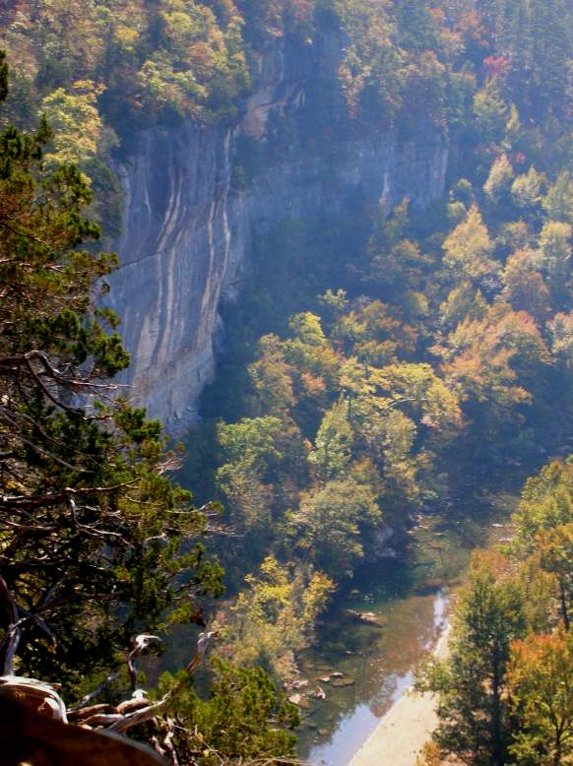
Buffalo National River
The Buffalo National River, became the first national river in the United States on March 1, 1972. It is one of the few remaining unpolluted, free-flowing rivers in the lower forty-eight states.
In a time when the Corp of Engineers was damming most major rivers for flood control purposes, local efforts to preserve the river were successful.
The park offers canoeing, camping, and more than 100 miles of hiking trails with majestic bluffs.
Today, the Buffalo National River is one of the leading tourist destinations in Arkansas, with park visitations averaging more that 800,000 visitors a year.
Businesses supporting recreational equipment, services and overnight lodging have become commonplace.
Notes:
During the 1960’s when many rivers were being dammed for flood control a group of local outdoors people lead by Neal Compton of Rogers succeeded in preservation of the Buffalo as a naturally flowing river through designation as the first National River.

Slide 38
Entrepreneurs
Arkansas has served as home to many entrepreneurs from small companies such as Aromotique or Yarnell to Walmart or Murphy Oil
Entrepreneurs are innovators who identify market opportunities and take the necessary risks to bring those products to market.
Arkansas has a wealth of entrepreneurs throughout its history.

Slide 39
Arkansas Entrepreneurs
Notable examples include:
Patricia P. Upton – Aromatique
Sam M. Walton –Walmart
Sissy Jones - Sissy’s Log Cabin
JM Products, Inc. - Ethnic Hair Care Products
Forrest L. Wood - Ranger Boats
Lorena Larson - Larson’s Language Academy
Charles H. Murphy Jr. - Murphy Oil
William T. Dillard - Dillard’s Stores
Don Tyson – Tyson Foods
Notes:
Arkansas has been the home of a relatively large number of entrepreneurs.

Slide 40
Sharing
Contributions of philanthropic organizations
Walton Family Foundation
Wal-Mart Foundation
Winthrop Rockefeller Foundation
Winthrop Rockefeller Trust
Walton Family Charitable Support Foundation
Charles A. Frueauff Foundation
Arkansas Community Foundation
Ross Foundation
Harvey and Bernice Jones Center for Families
Murphy Foundation
Windgate Charitable Foundation

Slide 41
Arkansas Philanthrophy
Between 1997 & 2004, AR ranked among top 7 state in individual charitable contributions while being among the five least wealthy
National or international nonprofit groups
Heifer International – LR – eliminate starvation by enable low-income people to feed themselves on a sustained basis
Potluck Food Rescue for Arkansas – redirects otherwise wasted food to low-income Arkansans
AR Foodbank Network & AR Rice Depot – work to relieve hunger and malnutrition

Slide 42
Economic Development
Economic development is dependent on these factors.
Development of human capital (education and training)
Infrastructure development (transportation, communications, financial, and utilities)
Capital formation (factories and machines)
Entrepreneurship (recognizing market opportunities and taking risks)

Slide 43
Current Economic Profile for Arkansas
Headquarters of four Fortune 500 companies: Dillard’s, Murphy Oil, Tyson Foods, and Walmart
Arkansas Per Capita Income $28,473 – 2006
US Per Capita Income $36,714 – 2006
Per Capita Income by county
Arkansas Labor Force Data
Inflation and Prices
Census Bureau QuickFacts

Slide 44
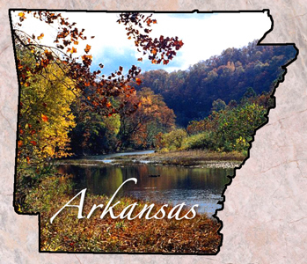
Discussion Questions
What type of businesses do you think would help Arkansas the most in the 21st century?
How do we develop these types of businesses?
What could you study that would develop your human capital and position you to make a difference in the future?
Notes:
Answers will vary. A few ideas are provided but please remember that these should only be added to the student ideas if they do not surface. 1) Arkansas is very interested in developing businesses that support alternative energies. Health care is a growing industry also as new treatments are found and the aging baby boomers want services to help them live a better and longer lives. Health and nutrition are also of growing interest to people. 2) We can recruit global companies with these skills or we can develop them ourselves through entrepreneurship. 3) Environmental engineering is a field that is expected to have growth in the future. Studying science and mathematics can prepare you for many careers and job possibilities. Education and health care are usually jobs that will be in demand.

Slide 45
PowerPoint Presentation
Created by Drs. Thomas McKinnon
& Rita Littrell
With technical support from Ms. Amy Moore
For the Bessie B. Moore Center for Economic Education
Sam M. Walton College of Business
University of Arkansas

